Slide 1

PGCP Presentation
Public Speaking & Stage Fear
A Group Presentation on Communication & Professional Development
Presented by: Member 1 • Member 2 • Member 3 • Member 4 • Member 5
Batch / Roll No: PGCP-XX | Date: DD Month YYYY
C-DAC • PG Certificate Program • AC/BDA/ITISS/ESD {Put your Course}
Notes:
TITLE SLIDE — Fill in: (1) Your actual topic title, (2) Group member names, (3) Batch/Roll number, (4) Presentation date.

Slide 2
Agenda
What we will cover today
1
Member 1: What is Stage Fear & Why It Matters
4
Member 4: Data & Proven Techniques
2
Member 2: The Brain Science Behind Fear
5
Member 5: Discussion, Takeaways & Close
3
Member 3: Real People Who Overcame It
6
Q & A + References
Notes:
AGENDA SLIDE — Replace the 6 agenda items with your actual section headings. Each member should own at least one section.

Slide 3
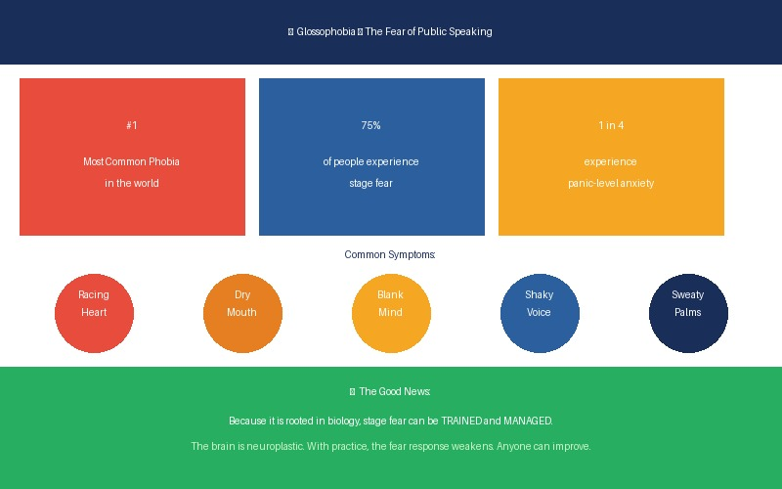
Introduction
SECTION 01
What Is Public Speaking & Stage Fear?
📷 Add Image / Diagram
(relevant to your topic)
Public speaking means delivering ideas to a live audience — in class presentations, job interviews, team meetings, even answering questions. Stage fear (Glossophobia) is the intense anxiety that arises when doing so.
Symptoms: shaking hands, dry mouth, racing heart, blank mind, trembling voice. It exists on a spectrum from mild butterflies to full panic attacks — and affects students, professionals, and world leaders equally.
💡 Stat: 75% of people fear public speaking more than death — making it the world's most common phobia.
Speaker Note: State your name before you begin. E.g. "Hi, I'm [Name], I'll introduce today's topic."
Notes:
INTRODUCTION — State your name, introduce the topic, explain its importance. Keep this slide under 90 seconds. Use an image or diagram on the right side.

Slide 4
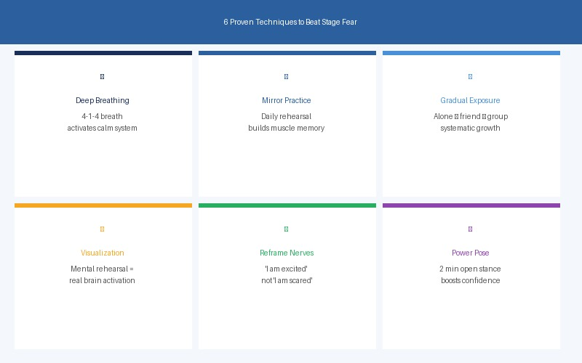
Why This Topic Matters
SECTION 01
Why This Topic Matters Professionally
📷 Add Image / Diagram
(relevant to your topic)
Employers rank communication as the #1 soft skill. Students who present confidently in placements, viva exams, and GDs gain a measurable edge — regardless of their technical knowledge.
Even in IT, developers must present to clients and managers. Poor communication makes brilliant ideas seem weak. Confident delivery makes average ideas sound great.
💡 Key insight: Public speaking is not a talent — it is a daily skill every PGCP professional will need.
Speaker Note: Explain the professional stakes clearly. Connect to the audience’s own placement interviews and viva experiences.

Slide 5
Key Concepts
SECTION 02
The science behind why we freeze when we speak
Glossophobia
The Amygdala Hijack
From Greek: glossa (tongue) + phobos (fear). Affects 75% of people globally. Symptoms: shaking, dry mouth, racing heart, blank mind. It is classified as a type of Social Anxiety.
The amygdala (brain's alarm) cannot tell apart a lion from an audience. It fires the same threat signal. Your logical brain gets partially overridden — this is called Amygdala Hijack.
Nervousness vs Anxiety
The Good News
Nervousness = mild, manageable, and actually sharpens focus. Anxiety = overwhelming and disruptive. Harvard research (Brooks, 2014): reframing nerves as excitement improves performance significantly.
Because stage fear is rooted in biology, it can be trained and managed. The brain is neuroplastic — with deliberate practice, the fear response weakens and confidence grows. Anyone can improve.
Notes:
KEY CONCEPTS — Replace icons, headings, and descriptions. Aim for 4 clear, distinct ideas. Use terminology specific to your topic.

Slide 6
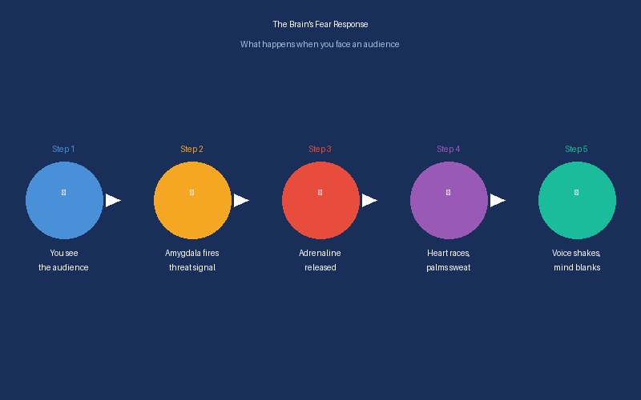
In-Depth Explanation
SECTION 03
What Happens in Your Body When You Speak
Point 1: Adrenaline floods your bloodstream within seconds of perceiving a threat (the audience). Your heart rate spikes to pump blood faster — preparing your muscles to run or fight.
Point 2: Blood moves away from digestion — causing dry mouth and stomach butterflies. Palms sweat (evolutionary grip response). Vocal cords tense making your voice shake. Breathing becomes shallow and fast.
Point 3: The prefrontal cortex (memory + rational thought) partially shuts down — which is exactly why you forget your content mid-sentence. This is not weakness. This is biology.
Evaluation Tip: This slide tests your Individual Content Contribution score. Know this section deeply — you'll be asked about it.
Notes:
CONTENT SLIDE — Each member should own one content slide. Replace sub-heading, points, and example box. This is your primary individual assessment slide.

Slide 7
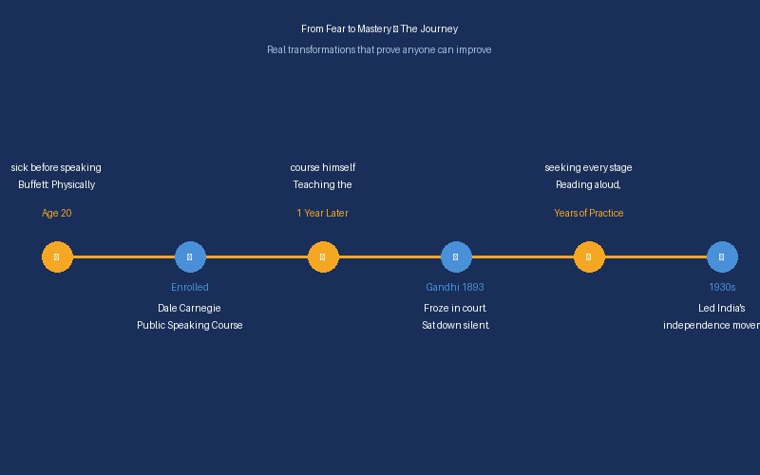
Real People: Buffett & Gandhi
SECTION 03
Real People Who Overcame Stage Fear
Point 1: Warren Buffett — one of the world's wealthiest investors — was so terrified of public speaking as a young man that he would physically get sick before having to speak. He avoided it entirely.
Point 2: At age 20, Buffett enrolled in a Dale Carnegie public speaking course. He practiced so consistently that within a year he was teaching it. Today he calls that diploma more important than his university degrees.
Point 3: Mahatma Gandhi froze completely during his very first court case as a lawyer. He could not say a single word — sat back down and had a colleague read his statement for him. He was humiliated.
Evaluation Tip: This slide tests your Individual Content Contribution score. Know this section deeply — you'll be asked about it.

Slide 8
Student Story & The Common Pattern
SECTION 03
The Student Story & The Common Pattern
Real-World
Example
Point 1: Priya (C-DAC student) had a final project presentation in front of 60 people. Despite excellent technical knowledge, she had crippling stage fear that had caused her to freeze before.
Point 2: She began practicing daily — first alone in her room, then mirror, then one friend, then two, building gradually. She used the 3-second breathing technique whenever panic rose.
Point 3: On the day, her voice shook at the start — but preparation carried her through. She scored top marks. A visiting recruiter offered her a job interview on the spot.
What Buffett, Gandhi and Priya all had in common: (1) They felt genuine fear. (2) They chose to face it. (3) They used deliberate, consistent practice. (4) They refused to let one bad experience define them.
Key message: You do not have to eliminate the fear. You just have to be more prepared than the fear is strong. Great speakers are not born — they are built, one practice session at a time.
Evaluation Tip: This slide tests your Individual Content Contribution score. Know this section deeply — you'll be asked about it.

Slide 9
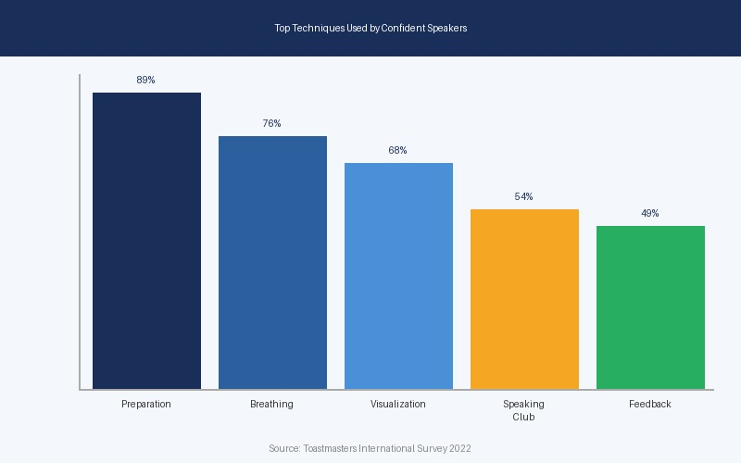
Supporting Evidence & Data
SECTION 04
75%
1 in 4
#1
Fear Public Speaking
Experience Panic Attacks
Most Common Phobia
National Institute of Mental Health
Chapman University Survey, 2023
Glossophobia ranks above death (Jerry Seinfeld)
Top Techniques Used by Confident Speakers
(Visualization) Bar chart: Preparation 89% | Breathing Exercises 76% | Visualization 68% | Joining Speaking Clubs 54% | Seeking Feedback 49%
Source: Toastmasters International (2022) | Insert a bar chart here via PowerPoint Insert → Chart showing these 5 techniques and their % usage among confident speakers
Notes:
DATA / EVIDENCE SLIDE — Replace placeholder stats with real data relevant to your topic. Cite sources. Charts and visuals boost your Slide Design score.

Slide 10
Proven Techniques — Part 1
SECTION 04
Proven Techniques — Part 1
Point 1: Technique 1 — The 3-Second Deep Breath: Inhale through nose for 4 counts, hold 1, exhale slowly for 4. This triggers the parasympathetic nervous system — your body's natural calm-down switch. Stanford neuroscientist Andrew Huberman confirms it is the fastest way to reduce acute stress.
Point 2: Technique 2 — Mirror Practice: Speak your content aloud in front of a mirror daily. Builds muscle memory — just like a dancer rehearsing choreography. Train your brain to associate the content with calm delivery.
Point 3: Technique 3 — Gradual Exposure: Start presenting alone → then to a mirror → then one friend → then a small group. Each step expands your comfort zone. Clinically proven to reduce phobias through systematic desensitisation.
Evaluation Tip: This slide tests your Individual Content Contribution score. Know this section deeply — you'll be asked about it.

Slide 11
Proven Techniques — Part 2
SECTION 04
Proven Techniques — Part 2
Real-World
Example
Point 1: Technique 4 — Visualization: Spend 5–10 mins before sleeping mentally rehearsing your presentation going perfectly. Harvard Medical School research shows mental rehearsal activates the same motor cortex regions as physical performance. Elite Olympic athletes use this before every competition.
Point 2: Technique 5 — Reframe Nerves as Excitement: Harvard researcher Alison Wood Brooks (2014) found saying “I am excited” before speaking improves performance. Anxiety and excitement have identical body signals — only the label differs.
Point 3: Technique 6 — The Power Pose: Amy Cuddy's Harvard research suggests standing in an open, expansive posture for 2 minutes before speaking physically changes your hormones — increasing testosterone and decreasing cortisol — making you feel more confident before you say a single word.
Priya used Techniques 1, 2, and 5 in combination. Before her final presentation, she visualized success the night before, did the breathing exercise backstage, and told herself “I am excited” instead of “I am scared”.
Result: she scored top marks and received a job interview offer from a visiting recruiter. Each of these 6 techniques is free, takes under 10 minutes, and is backed by peer-reviewed research. Start using them today.
Evaluation Tip: This slide tests your Individual Content Contribution score. Know this section deeply — you'll be asked about it.

Slide 12
GROUP ACTIVITY
Let's Discuss!
Discussion Question / Activity
“Think of a time you had to speak in front of others — a classroom presentation, a job interview, or even a group discussion.
What did you feel in that moment, and what did you do to get through it?”
Give the audience 2 minutes to reflect individually, then share with the group. Each group member will also briefly share their own personal technique for managing nerves.
Notes:
ACTIVITY SLIDE — Ask an engaging question or run a quick activity. Audience interaction boosts your Individual Delivery score. Keep it to 2–3 minutes.

Slide 13
Key Takeaways
SUMMARY
What to remember from today's presentation
1
Stage fear is normal and universal — 75% of people experience it. You are not alone, and it does not mean you are not capable.
2
Preparation is your greatest weapon. The more you rehearse — alone, in front of a mirror, with friends — the more confident and natural you will sound on the actual day.
3
Try the 3-second deep breath technique before your next presentation. It activates the calm system in your brain and signals to your body that you are safe.
4
“All the great speakers were bad speakers at first.” — Ralph Waldo Emerson. Public speaking is a skill, not a talent. Start speaking, start growing.
Notes:
KEY TAKEAWAYS — Each takeaway should correspond to a core idea from your presentation. Keep sentences short and impactful. This slide shows your group understood the topic deeply.

Slide 14
References
Cite your sources — it shows research depth and builds credibility
[1] Dwyer, K. K., & Davidson, M. M. (2012). Is Public Speaking Really More Feared Than Death? Communication Research Reports, 29(2), 99–107.
[2] Toastmasters International. (2022). Techniques for Overcoming Public Speaking Anxiety. Retrieved from https://www.toastmasters.org
[3] National Institute of Mental Health. (2023). Social Anxiety Disorder & Glossophobia. Retrieved from https://www.nimh.nih.gov
[4] Anderson, C. (2016). TED Talks: The Official TED Guide to Public Speaking. Houghton Mifflin Harcourt.
[5] Carnegie, D. (1936). The Art of Public Speaking and How to Win Friends & Influence People. Simon & Schuster.
Notes:
REFERENCES — Use APA or MLA format consistently. Aim for at least 3 quality sources (not just Wikipedia). This directly affects your Content Quality score in Section A.

Slide 15
Thank You!
We welcome your questions!
Presented by: Member 1 • Member 2 • Member 3 • Member 4 • Member 5
Topic: Public Speaking & Stage Fear
Q&A Tips:
• Listen carefully before answering • It's OK to say 'That's a great question, let me think…'
• Support teammates if they're asked about your topic • Be concise and confident
Notes:
Q&A SLIDE — During Q&A, any evaluator can ask any member about any part of the presentation. Review all sections, not just your own. Q&A handling contributes 70% of your individual score in Section B.

